Slide 1
US VISA PROCESS INITIALIZATION
Step 1: Go to the following link: http://www.ustraveldocs.com/in/index.html
Step 2: Scroll down and click on “Complete my DS-160”
Step 3: Under the section More Information:
Click on DS-160 form online: you will be directed to the below mentioned link:
https://ceac.state.gov/genniv/
Fill up the form and submit it to get the CEAC barcode.
Step 4: Refer to the next slide to create a profile to generate visa fee deposit slip.

Slide 2
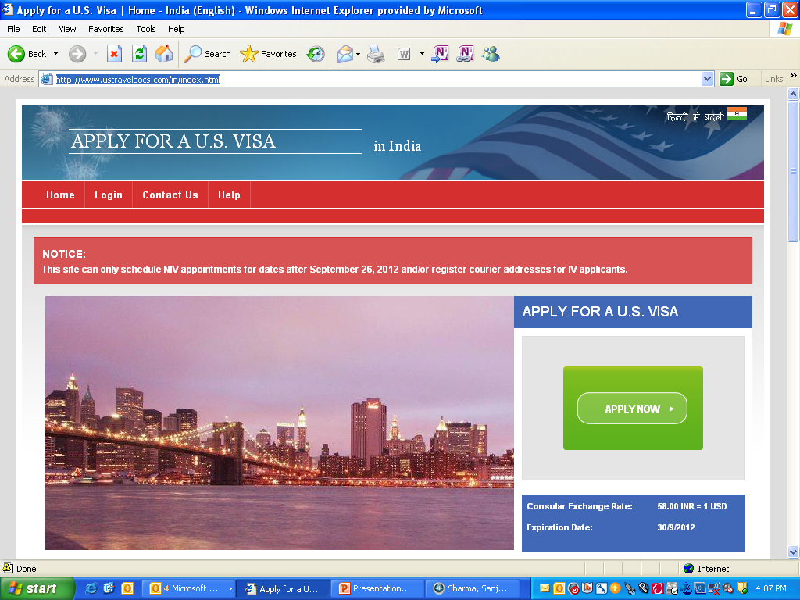
Click on Apply Now

Slide 3
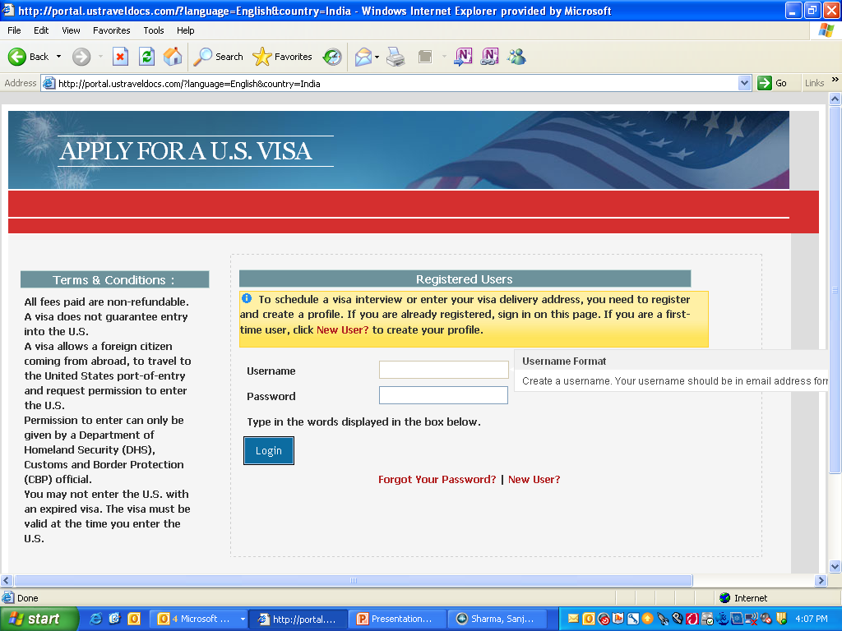
Click on NEW USER

Slide 4
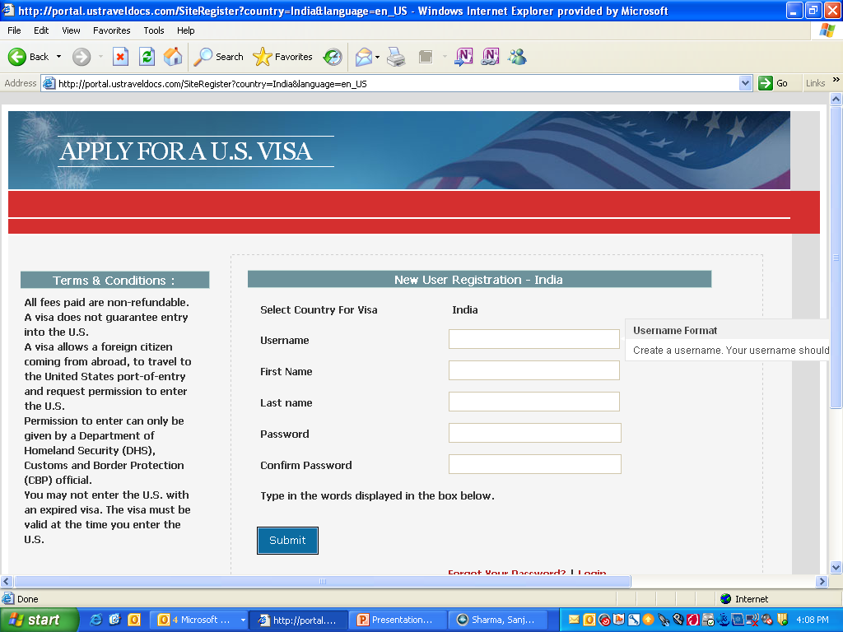
Fill in the information and click on SUBMIT

Slide 5
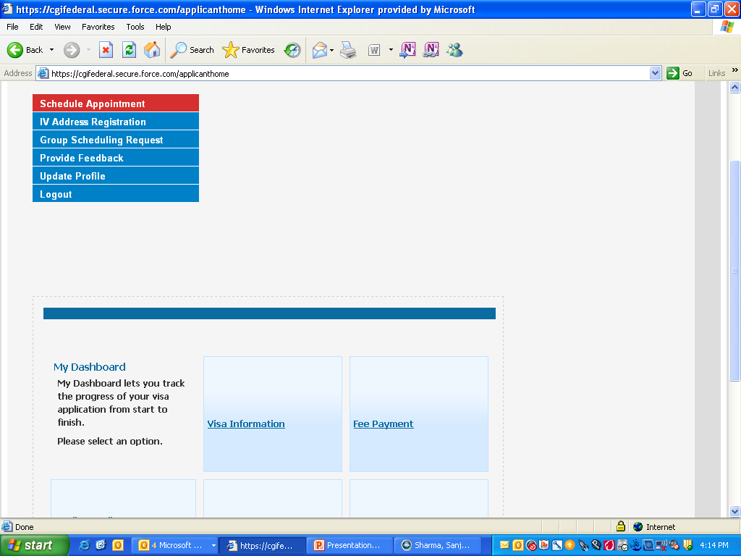
Click on UPDATE PROFILE

Slide 6
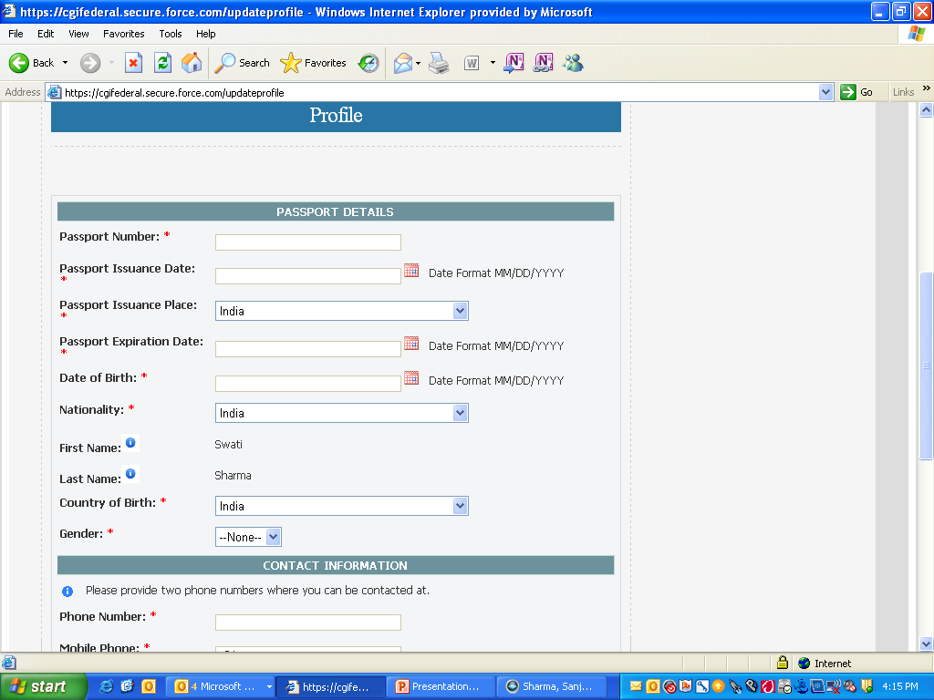
Scroll down to see this screen and fill in the information…

Slide 7
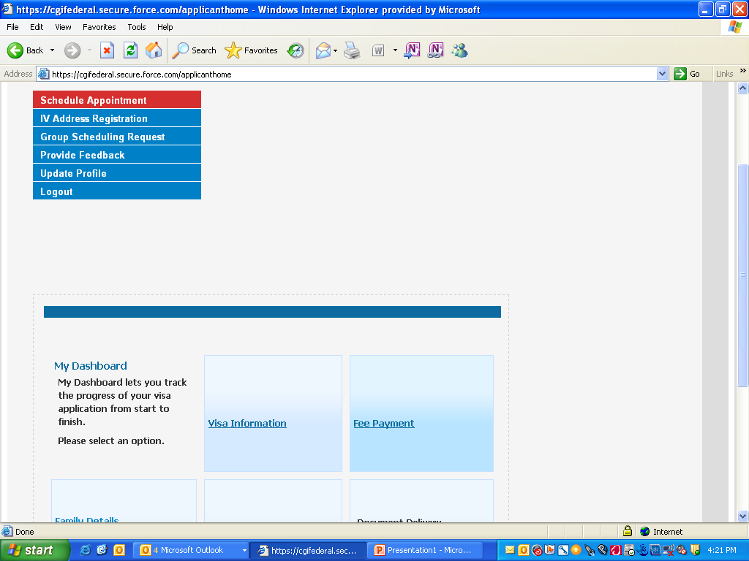
Click on SCHEDULE APPOINTMENT

Slide 8
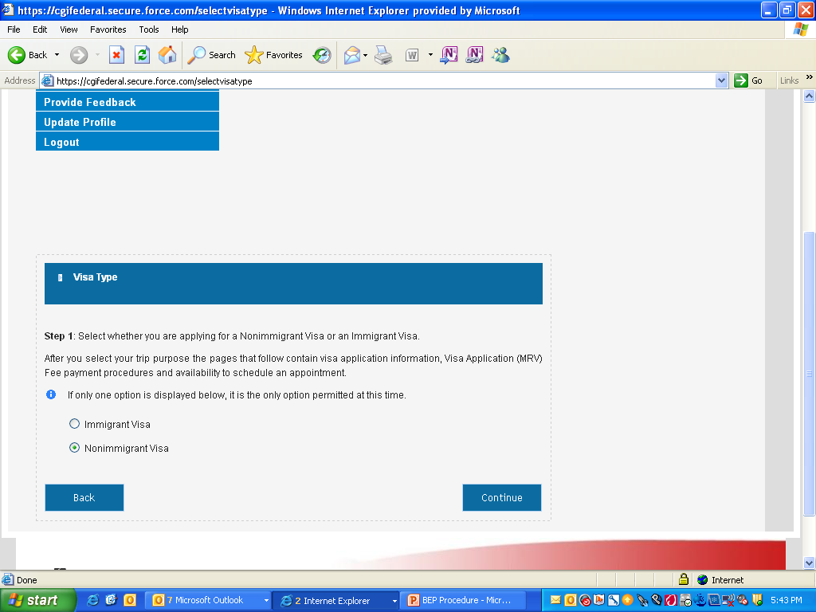
Click on NIV and Continue.

Slide 9
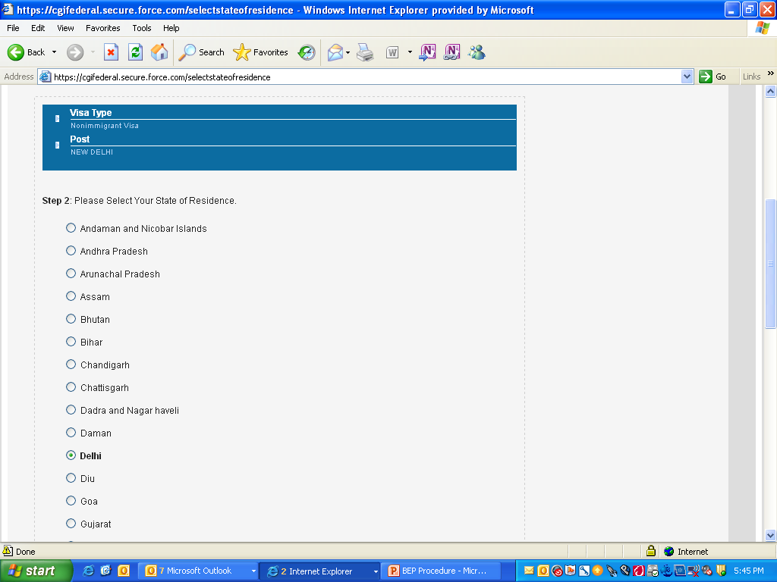
Click on State of Residence (current location)

Slide 10
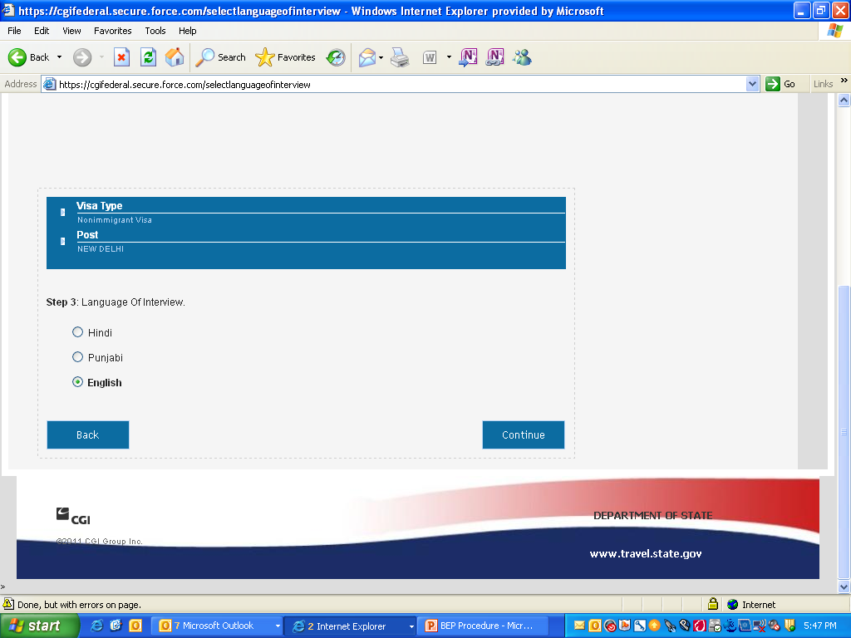
Click on preferred language of interview.

Slide 11
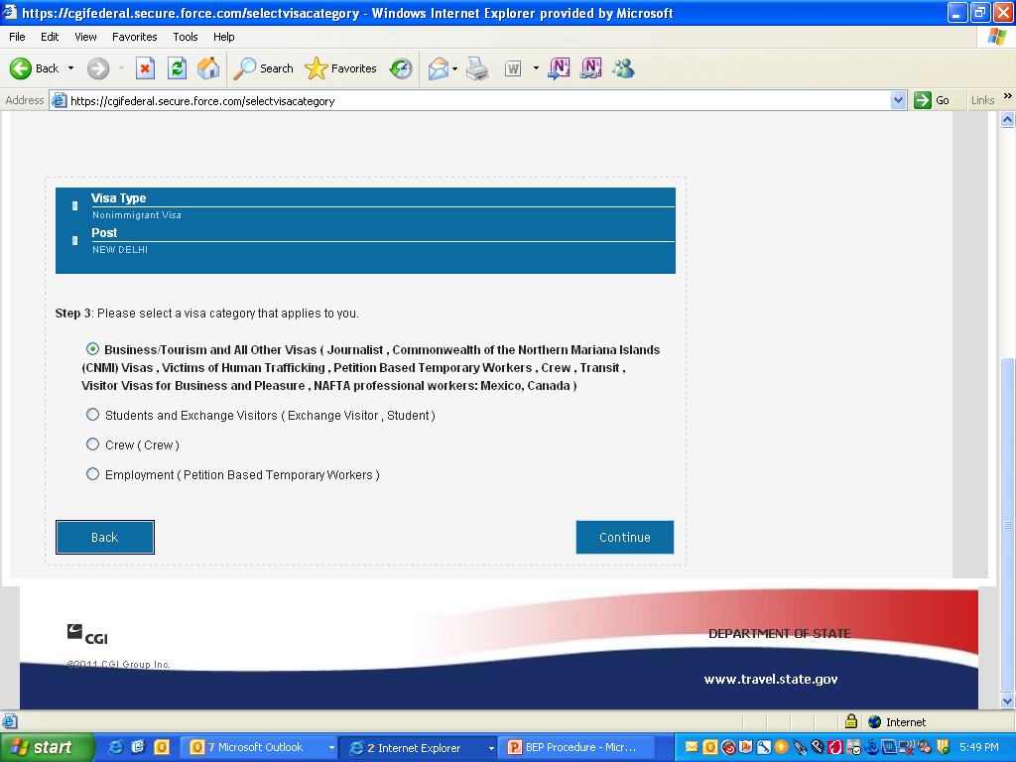
Click on your visa category

Slide 12
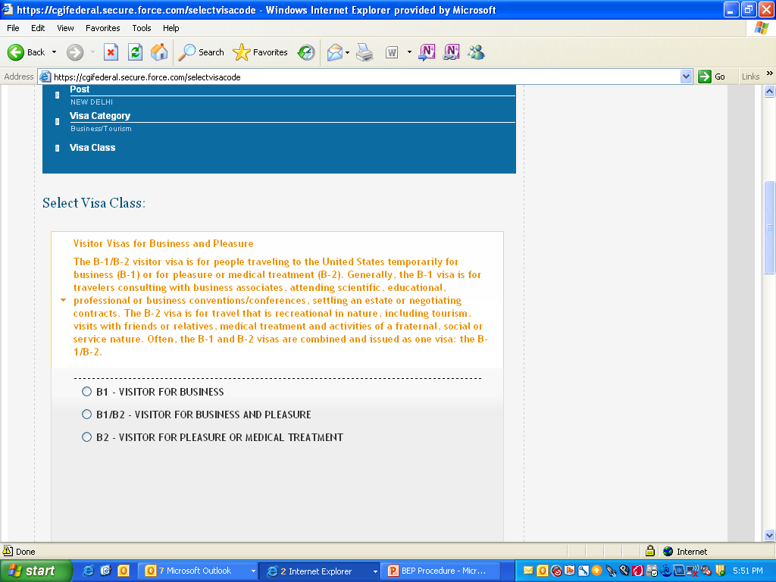
Select the visa class

Slide 13
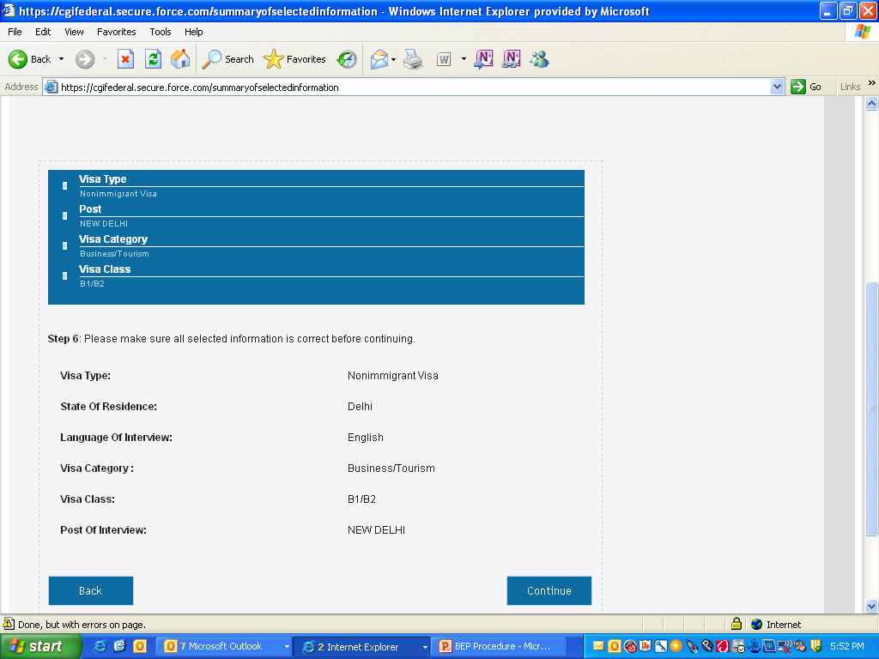
Check the details and click on Continue.

Slide 14
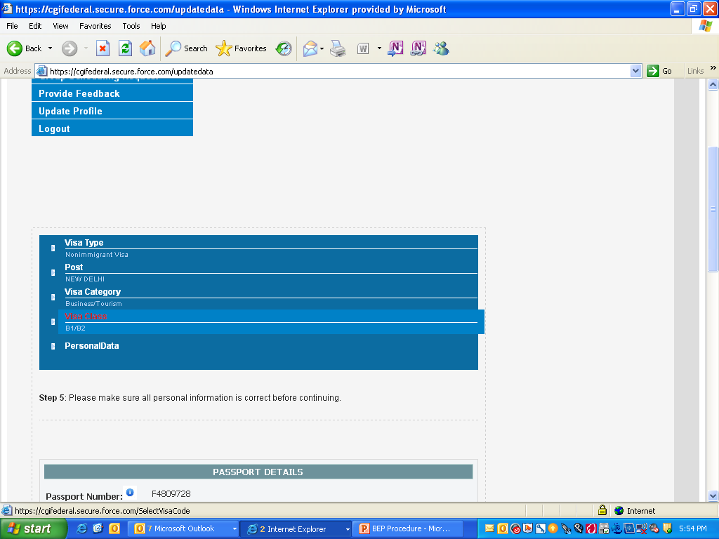
Fill in the Passport Details

Slide 15
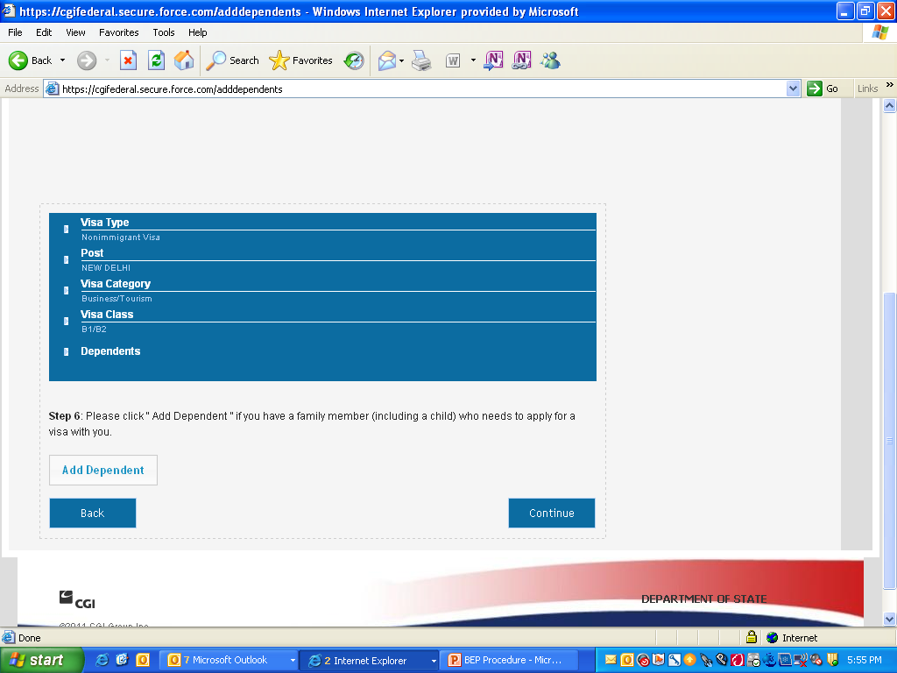
Add Dependent details if applicable else click on Continue.

Slide 16
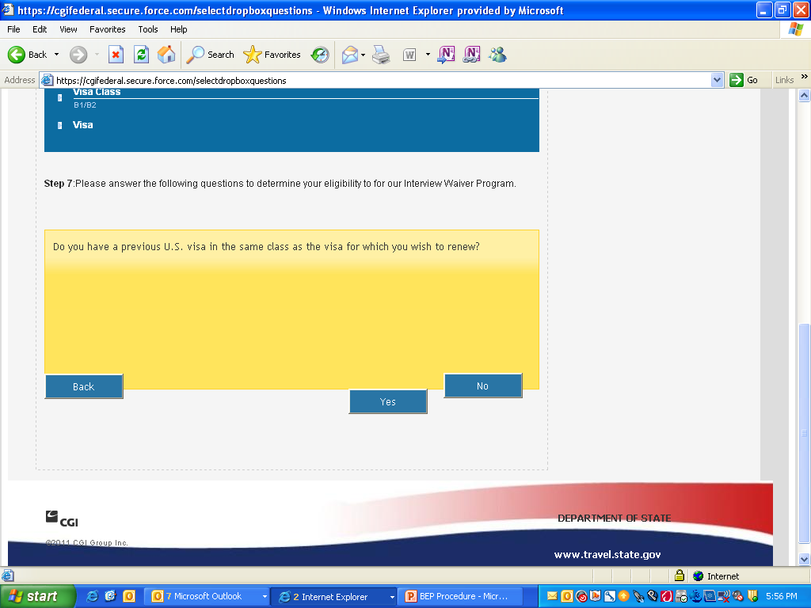
Click on YES or NO as applicable…

Slide 17
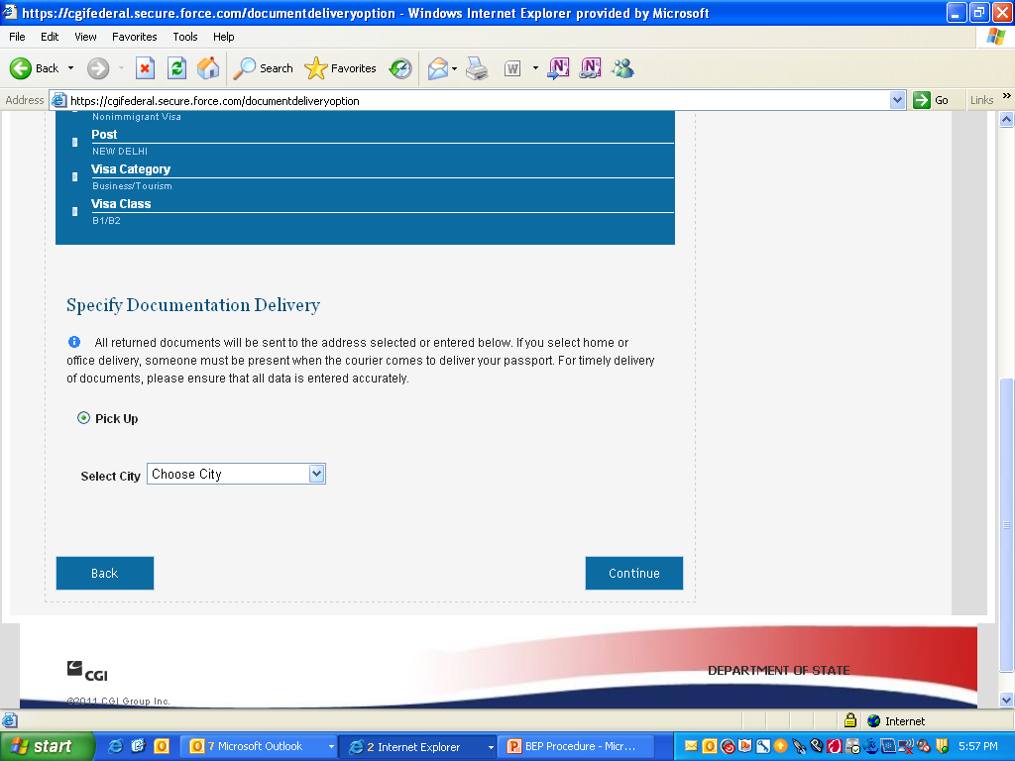
Select the relevant City and click on CONTINUE…

Slide 18
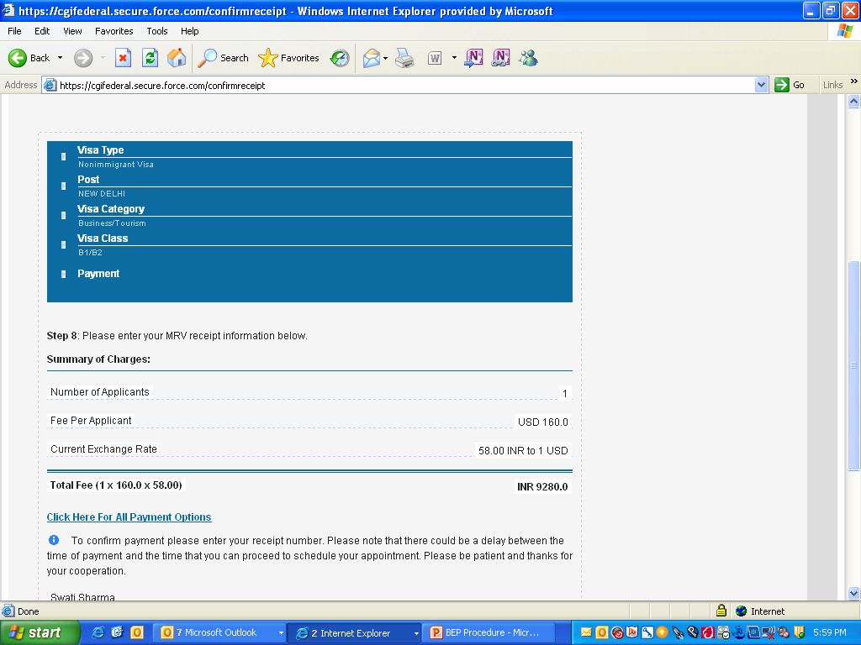
Click here for PAYMENT OPTIONS

Slide 19
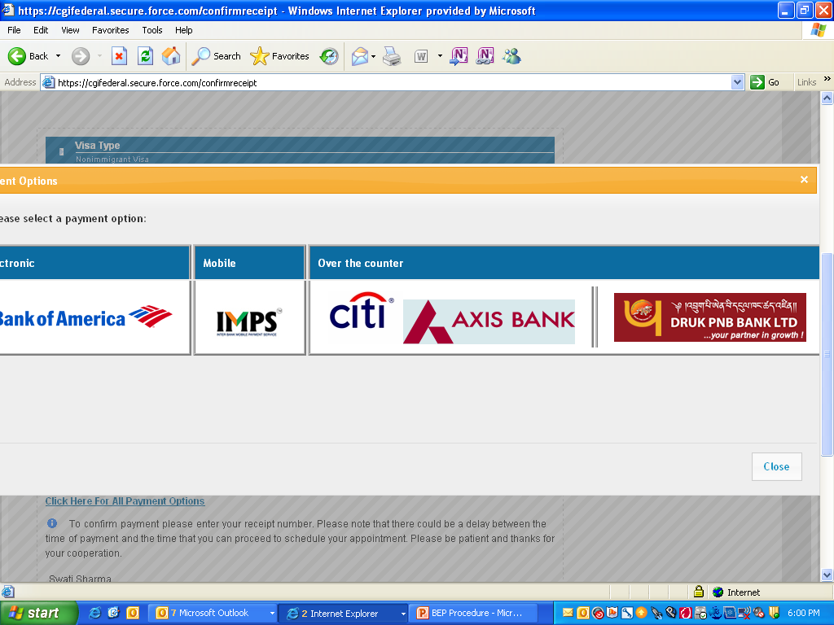
Click on OVER THE COUNTER

Slide 20
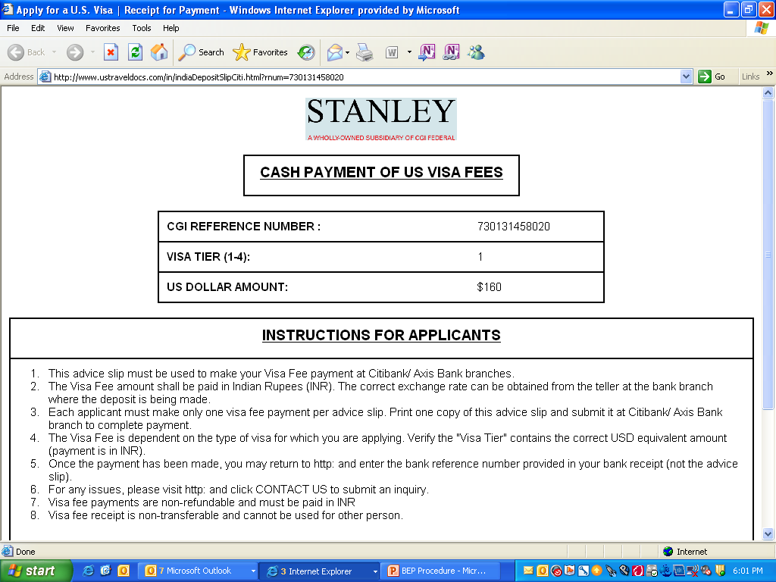
Print This Page

Slide 21
Logout from the Website Now
You need to take the printout of the visa payment sheet to the authorized banks. The list is available at the below mentioned link:
http://www.ustraveldocs.com/in/in-loc-bank.asp
The bank will provide you the INR value of the visa fee mentioned in US$. Pay the amount and get the payment confirmation number from the bank.
Note: Please do not schedule your interview yourself. It has to be routed through the Travel Desk only.

Slide 22
Share the following details for scheduling the visa interview
Name as on Passport
Passport No.
Passport issuance Date
Passport expiry Date
Country of issuance of the Passport
Type of visa being applied for
Date of Birth
Mother’s name
Mobile Number
Landline Number
E-mail address
City of current Residence
DS-160 confirmation number
Visa fee payment confirmation number
UID (user id issued at the time of profile creation)
Answer the following:
Have you had any refusal for a visa in any category after the most recent issuance?
Do you have a previous US visa in the same class which you wish to renew?
Was your previous visa issued in India?
Was your prior visa in same classification, still valid or expired within last 48 months?
Was your prior visa annotated “CLEARANCE RECEIVED”

Slide 23
Once all the above mentioned steps are completed, kindly share the required information with:
Swati Sharma : swati_sharma@uhc.com
Desk Phone: 0124 – 3094309
Desk Location: Tower B, 14-02
Please note that the SLA is 3 working days from the receipt of the complete information.
There are exceptional situations when the web servers are down which can lead to delay in scheduling the interviews. Such situations are beyond our control.

Slide 24
Details for BEP Letter
Kindly provide the following details in order to draft your BEP letter:
Duties
Place of Travel
Point of contact at place of travel (full office address)
Expected Date of Return
Applicant Name:
Applicant’s Passport Number:
Applicant DOB:
Visa Category:
Hire Date:
Position at company:
Yearly income in India:
Purpose of Travel: | (Can be expressed in paragraph form)
Expected Date of Departure:
Expected Duration of Stay:

Slide 25
THE END…

